Slide 1
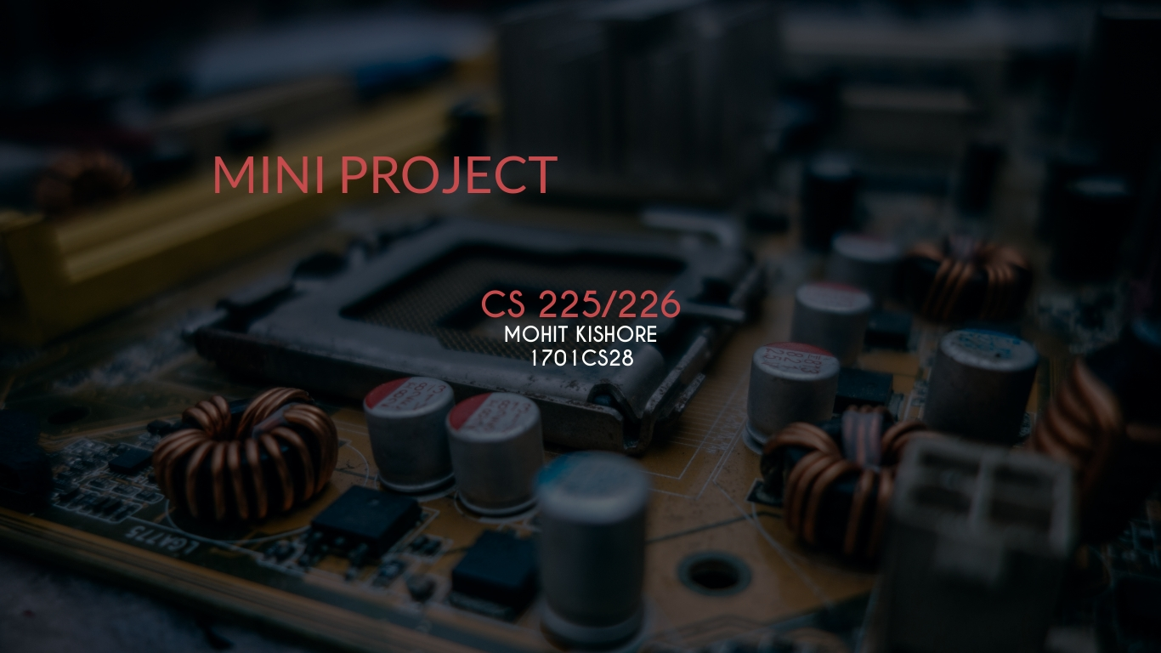

Slide 2

Part 1
MINI SOnar
Mohit Kishore (1701CS28)

Slide 3
TRAFFIC LIGHT SYSTEM
Here we simulate the working of a traffic light controller by using rom to store the sequence that generates required traffic signals.

Slide 4


Components USED:
WORKING:
ROM (address bit width-3, data bit width-3).
Counter (Rising edge, data bits-3).
Splitter (3 splits).
LED (Green, Red, Yellow).
The design upon simulation (simulate-> tick enabled) realises the working of a traffic light system while reading the output stored as a sequence in the ROM.
The sequence stored in the ROM is 1,3,2,4,0,4,2,1. This sequence produces the required traffic light system.
ROM is used for storing the sequence bit that is read as an output to provide the sequence of the traffic light.
The traffic light is simulated using LEDs of the required colours.
A counter is used to access the data through the addresses stored in the ROM.
A Splitter divides the 3-bit data output to 3 1-bit data outputs.
Reset button resets the entire system to beginning of the sequence.

Slide 5
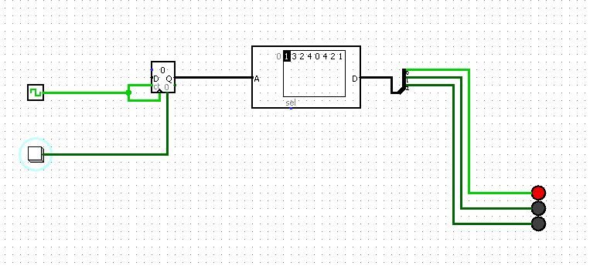
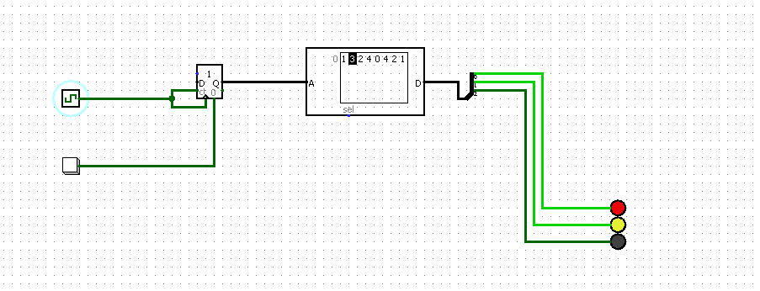
SIMULATION:

Slide 6
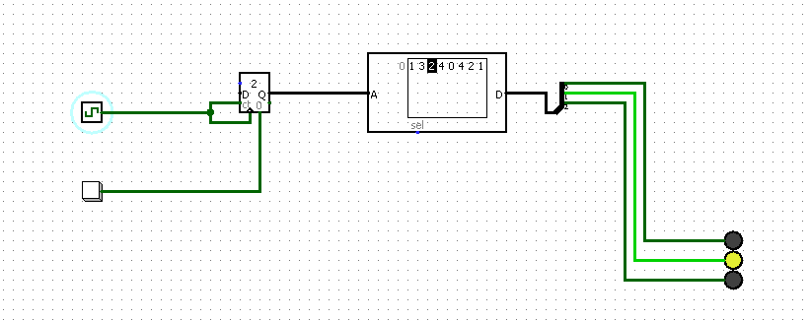
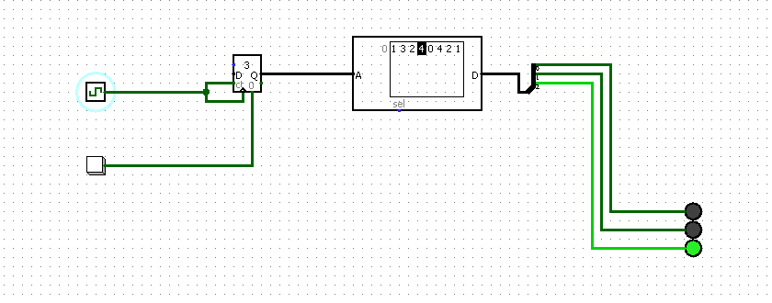
SIMULATION:

Slide 7
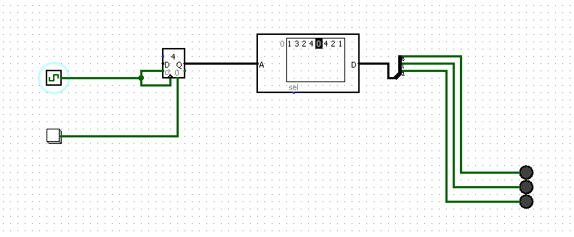
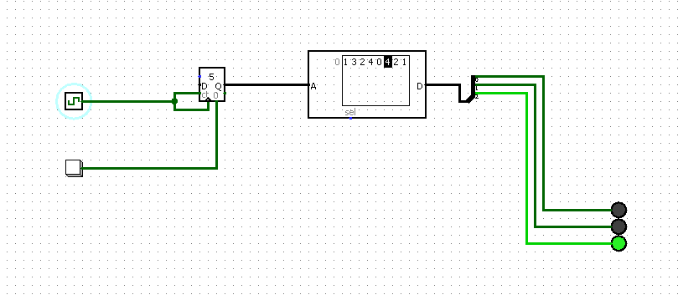
SIMULATION:

Slide 8
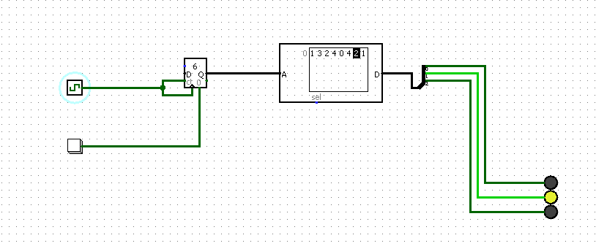
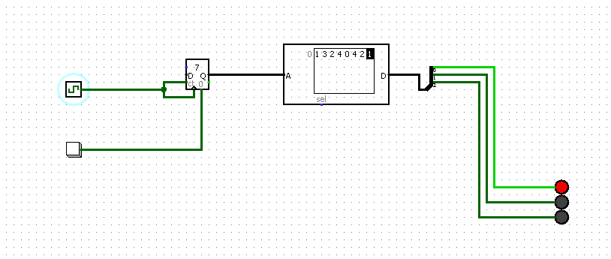
SIMULATION:

Slide 9
Problem Statement
How is it useful?
Q. Design a traffic system controller in logisim using a 3-bit data width ROM to store the traffic signal sequence.
This experiment may be useful in stimulating the usage of ROM and other memory blocks in practical problems in the user.

Slide 10
THANK YOU

